Slide 1

Exploratory Data Analysis
G2M insight Cab Investment firm
21st April 2023

Slide 2
Agenda
Executive Summary
Problem Statement
Approach
EDA
EDA Summary
Recommendations

Slide 3
Executive Summary
XYZ is a private equity firm in US. Due to remarkable growth in the Cab Industry in last few years and multiple key players in the market, XYZ is planning for an investment in Cab industry.

Slide 4
Problem Statement
Objective
Provide actionable insights to help XYZ firm in identifying the right company for making investment.
XYZ, as per their Go-To-Market (G2M) strategy, wants to understand the market before making the decision

Slide 5
Approach
Data Understanding
Understanding the Cab industry market
Analyzing the most profitable Cab company
Recommendations for investment

Slide 6


Data Exploration
4 individual data sets merged into 1 DataFrame
Time Period of the Data is from 31/01/2016 to 31/12/2018
Total Data points: 359392
Cab_Data
Transaction_ID
Customer_ID
City
Merge3
Assumptions:
Both the Cabs (Pink and Yellow) are introduced into the market at the same time.
Price charged, Cost of Trip and Income are all indicated in the same currency units USD as this data belongs to US cities.

Slide 7
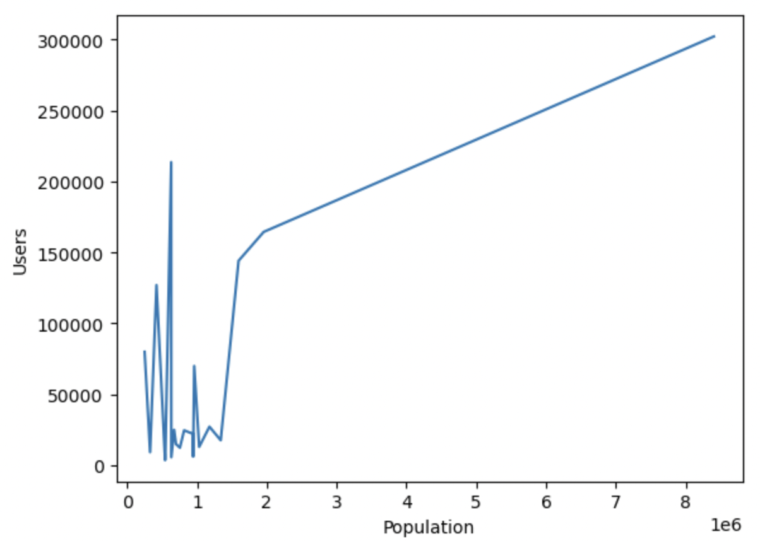
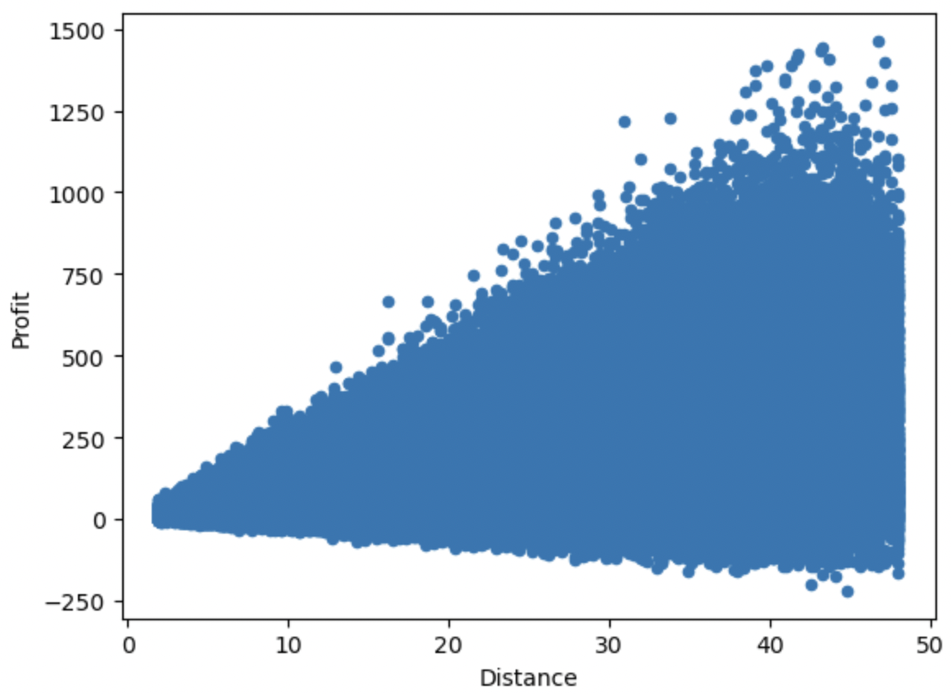
Understanding the Market
Does number of users increases as per the population?
Initially the number of users were uncertain with the population growth. However, after a certain population, the number of users increased linearly with the increase in population
Does profit increases per distance?
There are Losses (negative profit) incurred in trip as well. The greater the distance the greater the profits, but at the same time there are greater chances of losses as well, as the spectrum spreads wider as the distance increase.

Slide 8
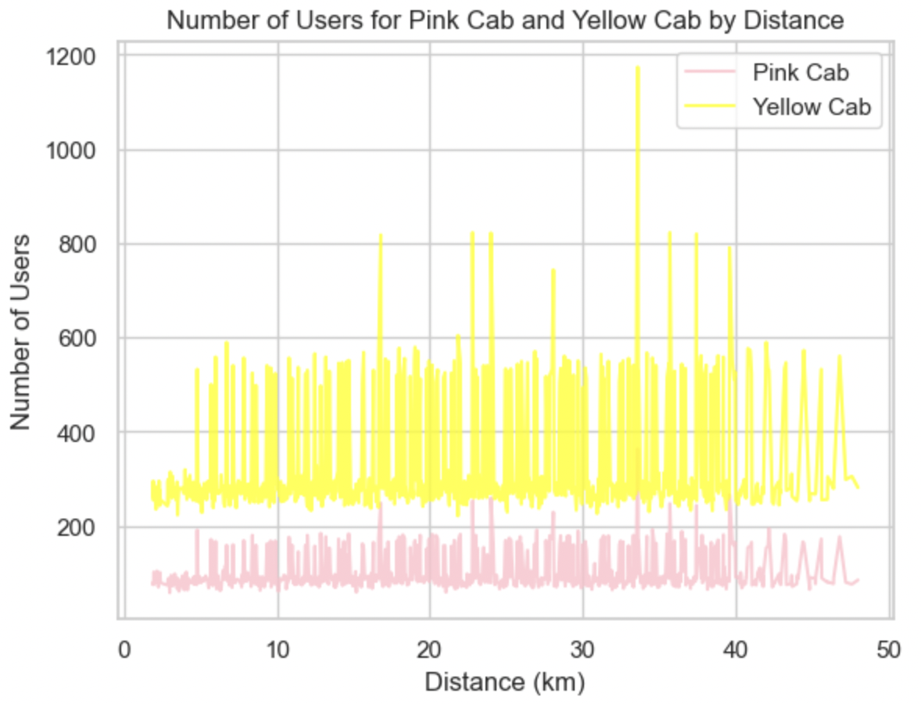
Understanding the market in terms of Pink and Yellow Cab
Do users prefer a specific cab as the distance increases?
No matter what the distance is, there are customers who travelled in Pink as well as Yellow cabs. There are more yellow cabs used than Pink cabs, but this could be because overall there is more yellow cabs used by the customers than the pink cabs are being used. But in this case, both the cabs are used at various distances.
Had the frequency (usage) of specific cab been more than the other as the distance increases, we could determine that one of the cab is more efficient or preferred while traveling long distances.
Hence there is no co-relation between distance and the company

Slide 9
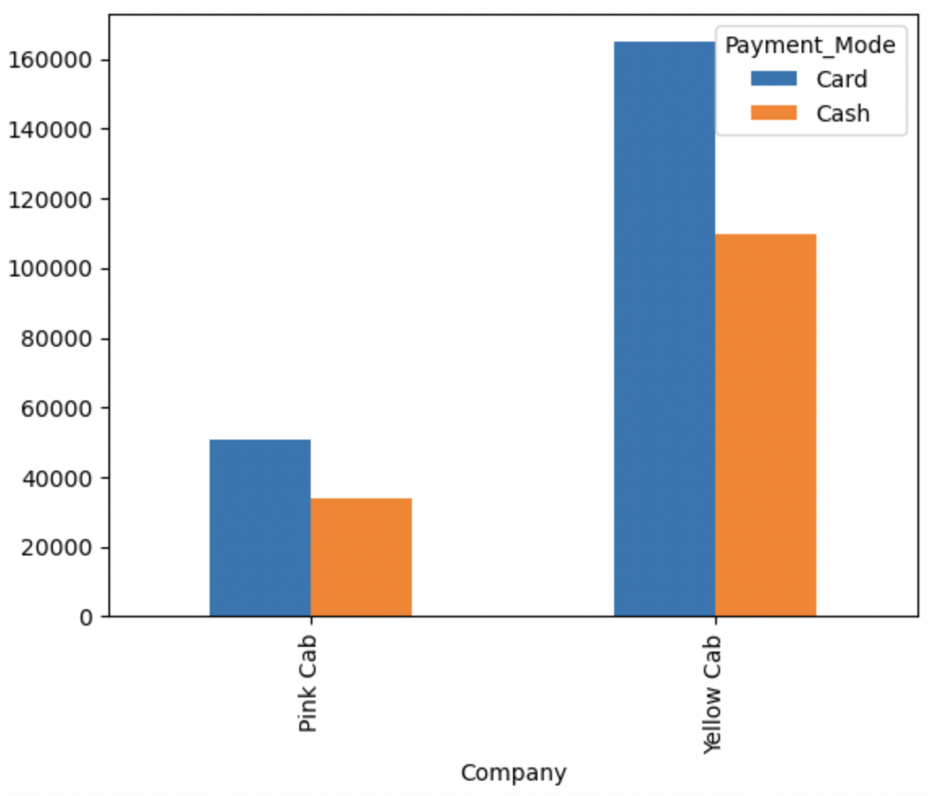
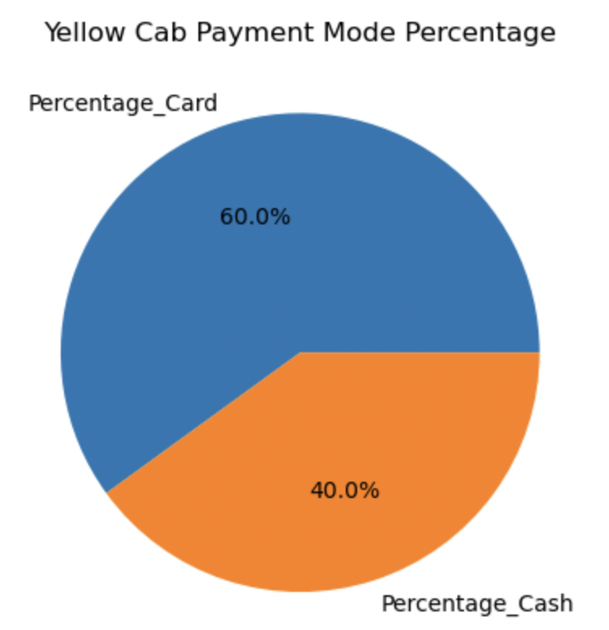
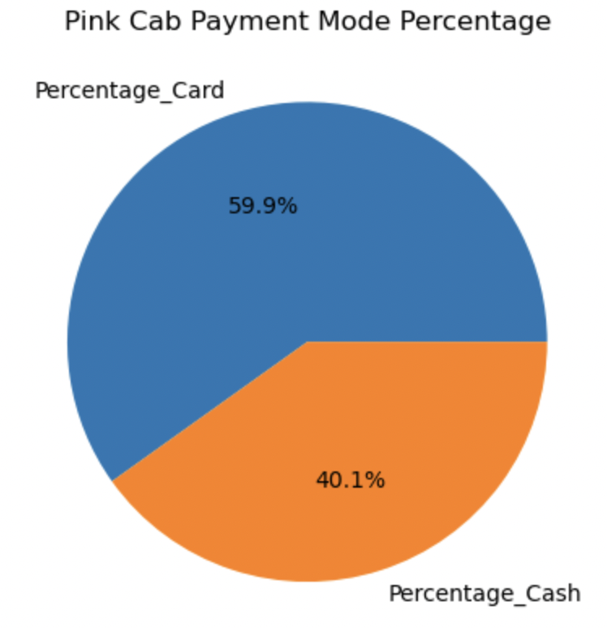
Understanding the market in terms of Pink and Yellow Cab
Both Pink Cab and Yellow Cab companies accept both card and cash payments, and the majority of their payments are made through cards. for both Pink Cab and Yellow Cab, more than half of their payments are made through cards

Slide 10
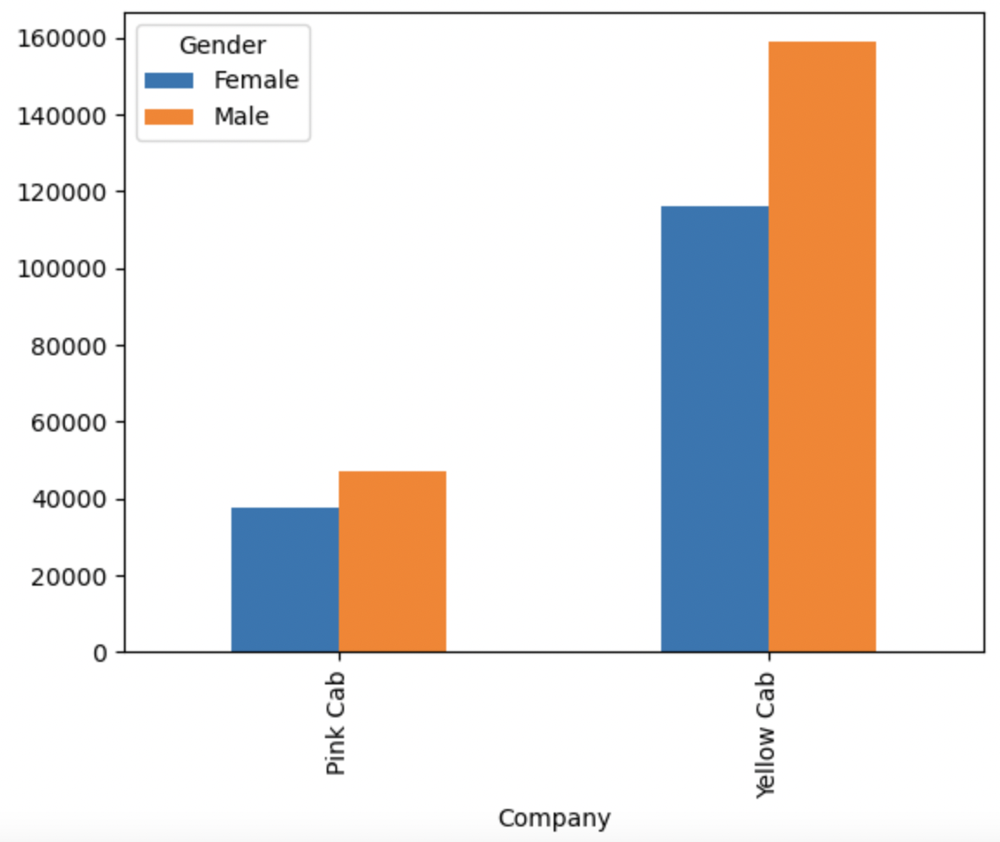
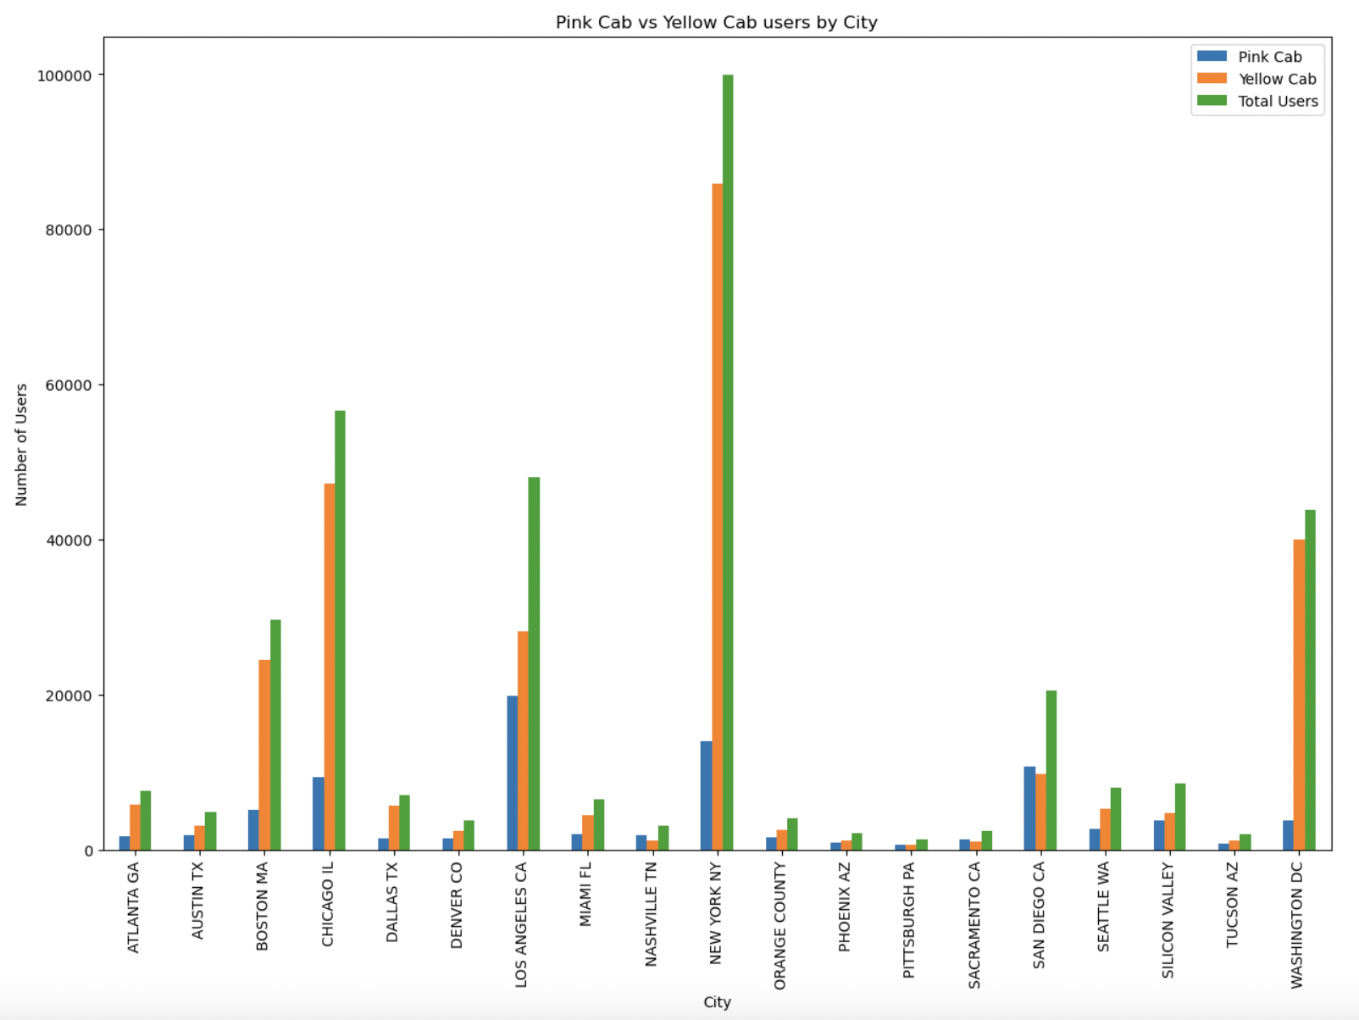
Understanding the market in terms of Pink and Yellow Cab
Both Pink Cab and Yellow Cab companies serve both female and male customers, with the majority of their customers being male.
In 3 of cities Pink Cab has gained a higher quantity of users than the Yellow cab which are Los Angeles, followed by New York and Chicago. The difference is not too significant.
However, for the rest of the cities, Yellow cab has attracted more number of customers with a very huge proportion in compared to the Pink Cab users in those cities

Slide 11
Insights about the Cab industry in the US Market
There are significant number of customers using the cab service in US for various range of distances travelled.
Though there are few losses incurred in some of the trips, the profits gained in the cab industries are noteworthy
There is almost similar weightage for both the mode of payment (Cash and Cards). Hence there is scope in both these payment modes in the cab industry.
Yellow Cab has taken the maximum percentage of customers among the cab users, but there is lot more scope of attracting more customers into the cab industry, as the stats show that only a small number of the entire population of the city are using the cab services

Slide 12
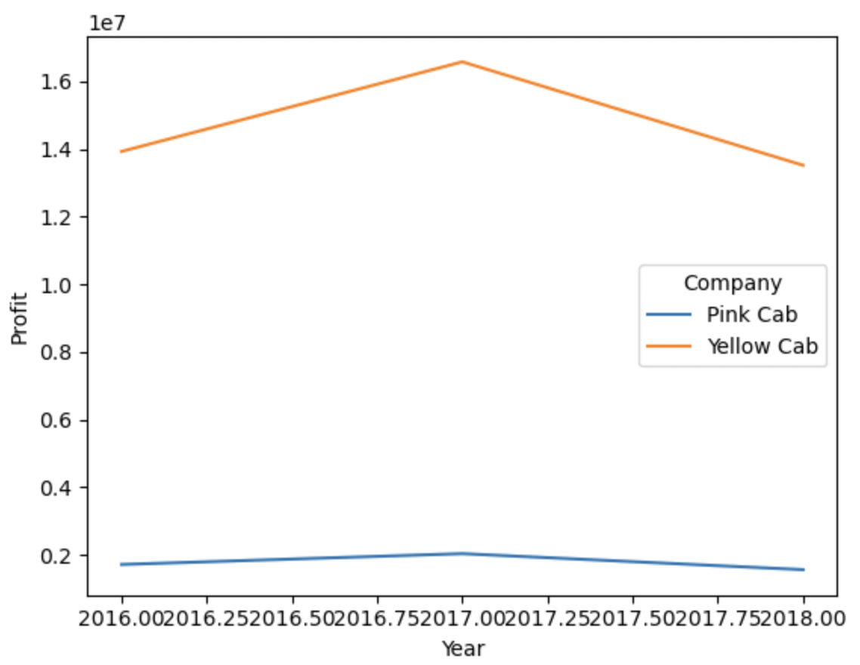
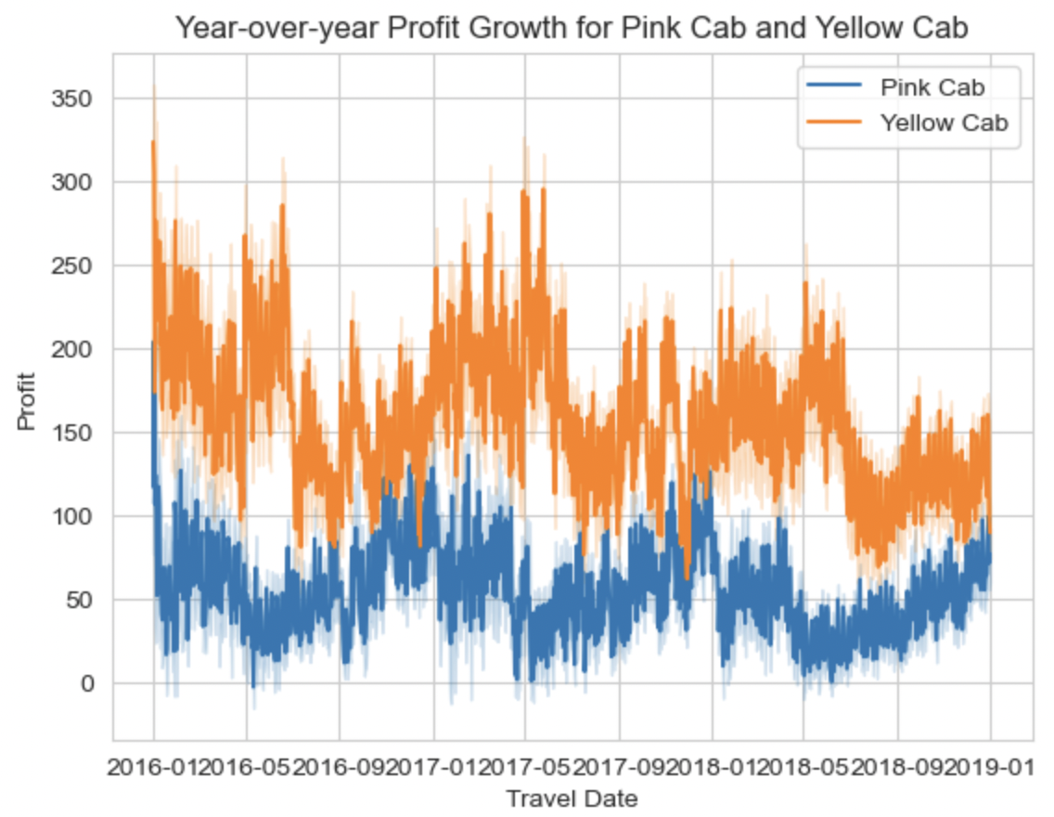
Analyzing the most profitable Cab company
YOY growth rate increases in terms of profits
There is a drop in Year-On-Year profit from year 2017 to 2018. However, the profits for Yellow cab is higher by a significant amount than the Pink Cabs.
From the 2nd graph we can illustrate that, at few points where the profit falls in the Pink cab, the profits for the Yellow cab has been increasing or higher. This shows that there is some strategy that Yellow cabs use or grab the opportunity at the time of fall which Pink cabs is supposedly unable to manage.

Slide 13
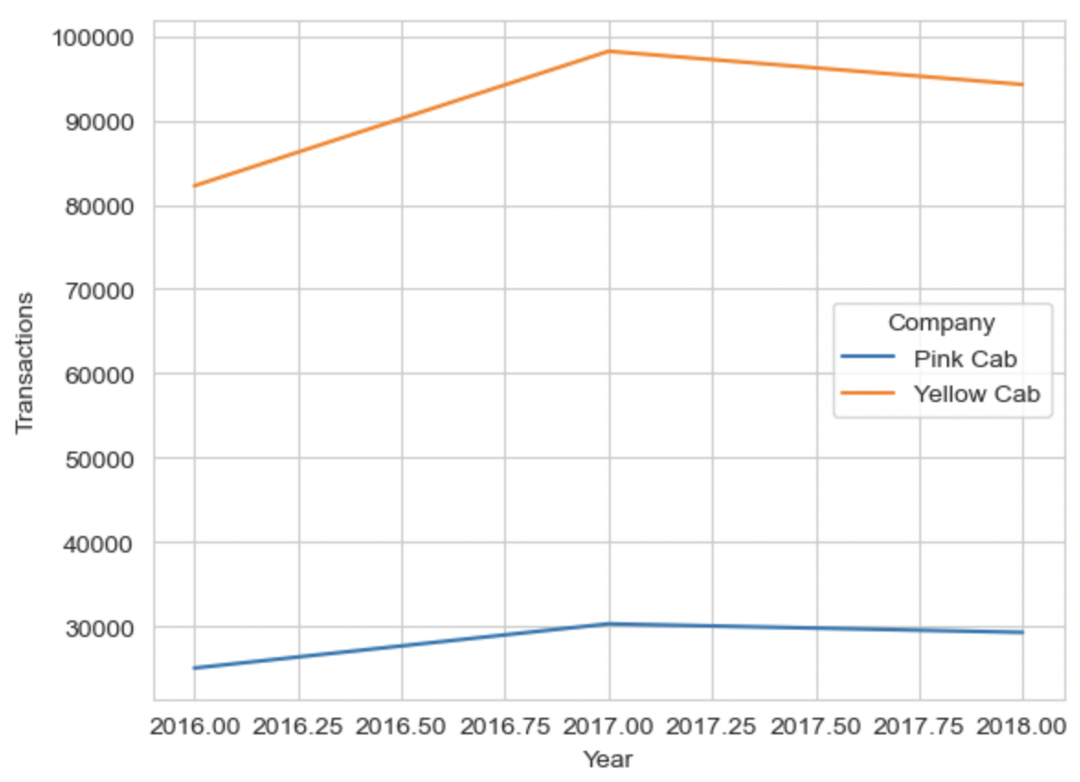
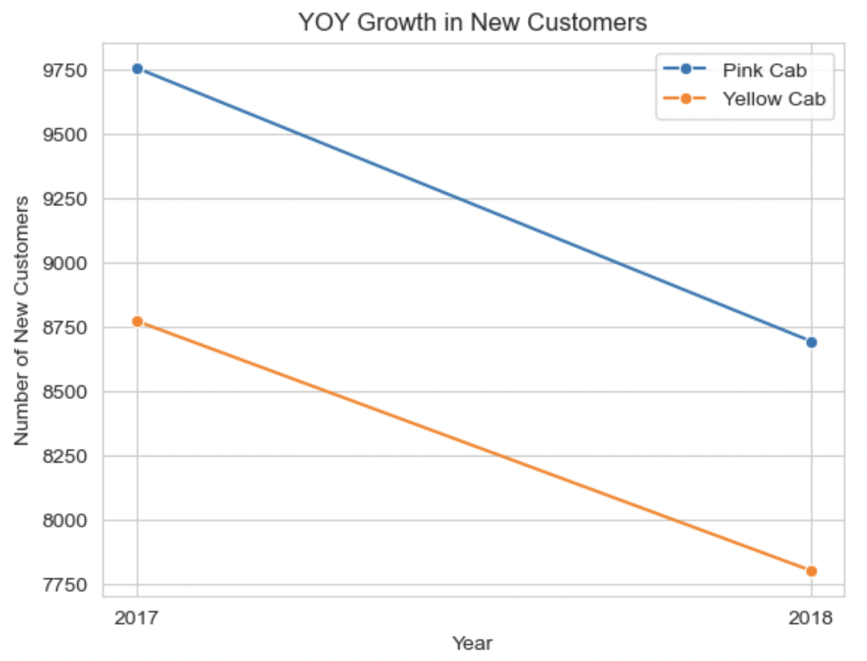
Analyzing the most profitable Cab company
YOY growth rate in terms of Users and New customers
There is a drop in number of users Year-On-Year from year 2017 to 2018. However, the number of customers using the Yellow cab is higher by a significant amount than the number of customers using the Pink Cabs.
Though addition of new customers have reduced on a whole by a bit, but there is still a noteworthy amount of new customers still getting added to the cab industry (9758 and 8696 in Pink Cab and 8774 and 7804 in Yellow Cab for the years 2017 and 2018 respectively).

Slide 14
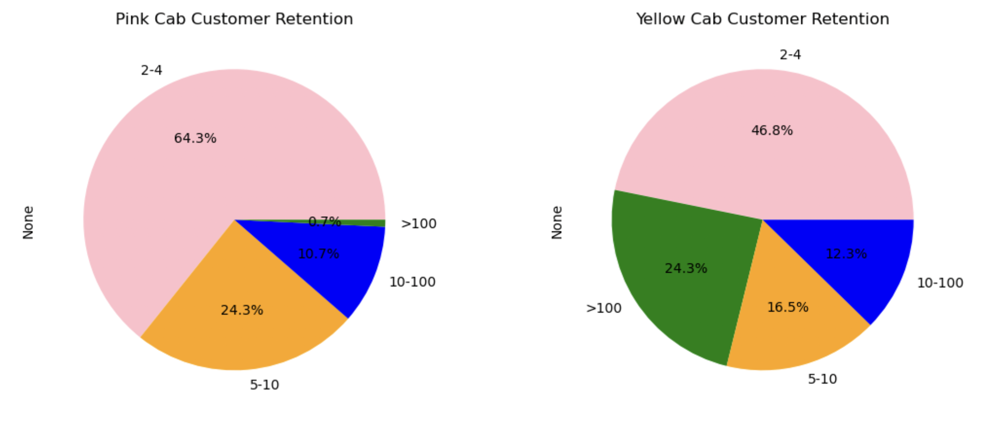
Analyzing the most profitable Cab company
YOY growth rate in terms of Users and New customers
The customer retention is greater for Yellow Cabs than for the Pink cabs.
We can see that 24.3% of the users has used the Yellow cab service for more than 100 times, where as for approximately the same number of times, only 0.7% of the customers has used the Pink Cab service.
Similarly, higher retention rate is for Yellow cab rather than Pink cab for customers using the service for more than 10 times.
This shows that Yellow cab is able to retain their customers in greater numbers.

Slide 15
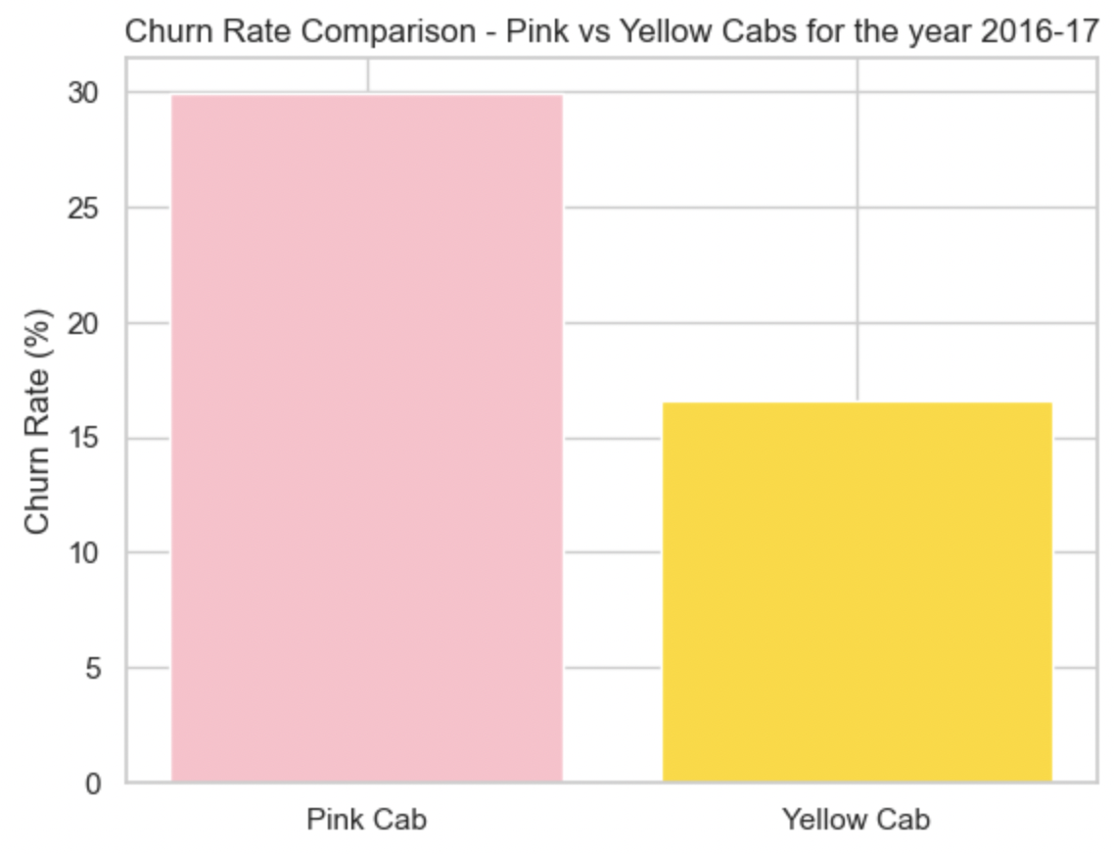
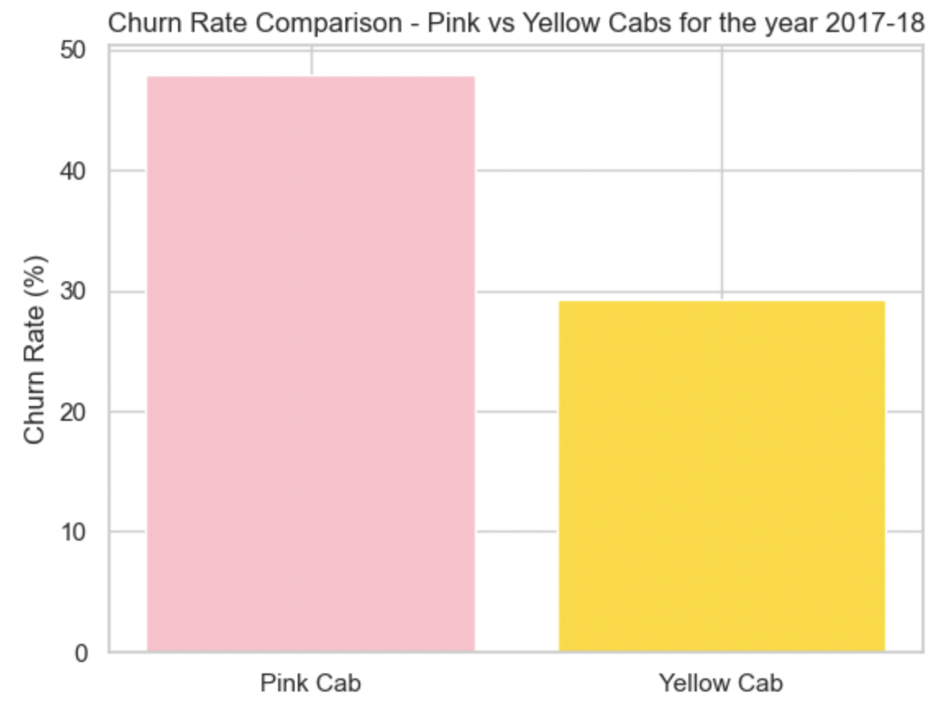
Analyzing the most profitable Cab company
YOY Churn rate
From 2016 to 2017 and from 2017 to 2018, the churn rate of Pink cabs has been higher than for Yellow cabs.
Churn rate in 2016 to 2017 for pink and yellow cabs has been 29.96% and 26.59% respectively. Churn rate in 2017 and 2018 for pink and yellow cabs has been 47.95% and 29.23% respectively. Which illustrates that the churn rate has gone up significantly in pink cabs whereas Yellow cabs were able to control their churn rate to at least maintain it as the similar rate as previous year.
Overall, the Churn rate for Pink Cab is higher than Churn rate for Yellow Cabs, as per above calculations

Slide 16

Summary and Recommendations
In all cities but three, Yellow Cabs are on top of Pink Cabs, except in threeYellow Cabs have a larger customer base compared to Pink Cabs.
Summary
Yellow Cabs have attracted a substantial number of customers in all of the given cities with the exception of three, where Pink Cabs have a slight advantage
There is a higher profit margin for Yellow Cabs than for Pink Cabs compared with Year-on-Year figures.
Pinks cabs attracted a little more number of ‘new’ customers than the Yellow cabs did
Yellow Cabs has greater customer retention rate than the Pink cabs.
The Churn Rate (the rate at which customers leave the service) is higher is Pink Cabs than in Yellow cabs.
This Photo by Unknown Author is licensed under CC BY-NC
Recommendations
Considering the Customer reach, Customer retention, Churn rate and the overall profits, investment in Yellow cab is much beneficial and recommended.

Slide 17
Thank You

